Slide 1
Data Structures

Slide 2
Agenda
Primitive Data types
Operators & Operands
Increment & Decrement Operators
Control Flow Statement & Loops
Patterns

Slide 3
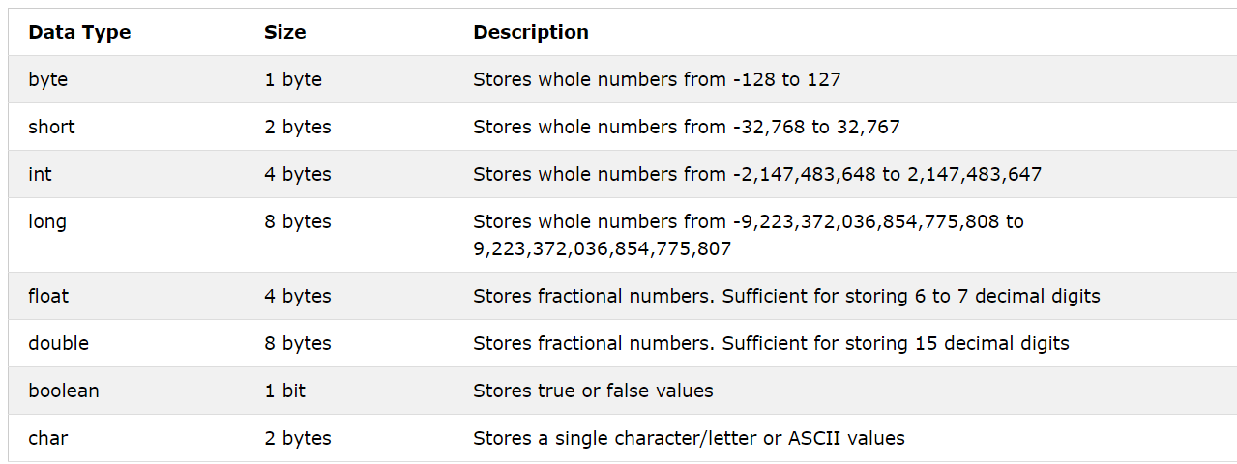
Primitive Data types
https://www.w3schools.com/java/java_data_types.asp

Slide 4
Primitive Data types
https://www.w3schools.com/java/java_data_types.asp

Slide 5
Type Casting - Widening

Slide 6
Type Casting - Narrowing

Slide 7
Type Casting

Slide 8
Operators & Operands
Let’s Jump to our IDE’s.

Slide 9
Increment & Decrement Operators
x++
++x
x--
--x

Slide 10
Control Flow Statements & Loops
Conditional Statement
if – else, only if, nested
switch
Loops (Iteration/ Repetition Statements)
for loop
while
do-while

Slide 11
Break vs Return

Slide 12
Instantiation Process
Student s = new
Student();

Slide 13
Heap & Stack Memory

Slide 14
Arrays

Slide 15
Pass by Value & Pass by Reference

Slide 16
THANK YOU

